Slide 1
WELCOME
Review No.1
Department of CSE

Slide 2

Department of Computer Science and Engineering
Advanced Machine Learning Approaches for Infant Cry Classification Using Audio Feature Extraction
PRESENTED BY
Kolasanakoti John Wesley
Vankayalapati Sunil
Velupula Venu
(21471A05N2)
(22475A0518)
(21471A05O0)
Under the Guidance of,
Nukala Vijay Kumar _{Msc(ME)}
Asst.Professor,
Department of Computer Science and Engineering,
Narasaraopeta Engineering College (Autonomous), Narasaraopet- 522 601.
Review No.1
Department of CSE

Slide 3
OUTLINE
Abstract
Introduction
Literature Survey
Research Gaps
Problem Statement
Objectives
Block Diagram / Flow Diagram
Methodology
Implementation
Results and Analysis
Conclusion & Future Scope
References
Question and Answers
Acknowledgements
Review No.
Department of CSE

Slide 4
ABSTRACT
This study introduces a machine learning framework for classifying infant cries using 457 audio features, including time-domain (e.g., Zero-Crossing Rate) and frequency-domain (e.g., MFCCs) features.
Mel-spectrograms and Time-Series Imaging enhance audio signal visualization. Data was divided into 80% training and 20% testing sets, with 10-fold cross-validation for model tuning. Several machine learning models were evaluated, including Logistic Regression, SVM, Decision Trees, Random Forests, and XGBoost.
The Random Forest model with MFCC features achieved a peak accuracy of 98.03%. Model performance was assessed using accuracy metrics, confusion matrices, and feature importance analysis. Results validate the combination of classical feature extraction and machine learning for cry classification. Future work aims to improve performance with advanced ensemble techniques​
Review No.
Department of CSE

Slide 5
INTRODUCTION
This project develops a machine learning framework to classify infant cries using advanced audio feature extraction techniques. The motivation stems from the need to understand infant cries as a primary communication method, especially in healthcare scenarios.
By analyzing features like MFCCs and Mel-spectrograms, the study enables timely and informed caregiving actions. Its importance lies in providing a non-invasive and accurate approach to early health monitoring.
Combining feature extraction with machine learning, the project achieves state-of-the-art results. This work significantly contributes to improving infant well-being and pediatric healthcare.
Review No.
Department of CSE

Slide 6
LITERATURE SURVEY
No | Title | Author | Journal Name & Year | Methodology Adapted | Key Findings | Gaps
1 | Machine learning based infant crying interpretation | Mohammed Hammoud, Melaku Negussie Getahun, | https://www.researchgate.net/publication/377297400 | Feature extraction, data augmentation, time-series imaging, Random Forest classifier. | 96.39% accuracy achieved in classifying infant cries using Random Forest | Small dataset, limited features, no deployment focus, lacks deep comparisons.
2 | Baby Cry Detection: Deep Learning and Classical Approaches | Rami Cohen Janis H. Zickfeld Yizhar Lavner | https://www.researchgate.net/publication/336989127 | Audio preprocessing, feature extraction, logistic regression, CNN, infant cry detection. | CNN outperforms logistic regression with higher accuracy, lower false positives. | Small dataset, limited features, no noise mitigation, deployment challenges overlooked.
Review No.
Department of CSE

Slide 7
LITERATURE SURVEY
No | Title | Author | Journal Name & Year | Methodology Adapted | Key Findings | Gaps
3 | A Novel Approach to Predict the Reason for Baby Cry using Machine Learning | Sahithi Vesangi, Saketh Reddy Regatte, Chalumuru Suresh, Baby Vadlana | https://www.researchgate.net/publication/372110030 | Audio preprocessing, FFT, CNN for training, RF classifier for prediction. | Machine learning, baby cries, CNN, Random Forest, accuracy, FFT, application. | Real-time detection, misclassification, dataset diversity, noise interference, accuracy, data augmentation,.
4 | Deep Learning Based Infant Cry Analysis Utilizing Computer Vision | Joohyun Cha, Gimin Bae | http://www.ripublication.com | The methodology integrates audio-video data using ensemble deep learning models. | The study combines audio-video data, achieving 97.41% accuracy in infant cry classification. | The study lacks diverse data, ethical considerations, and real-world validation.
5 | Infant Cry Detection With Lightweight Wavelet Scattering Networks | HAITAO CAO,HAISHAN CHEN, ANDJUNYING YUAN |  | The methodology integrates wavelet scattering and lightweight DNN models | Key findings include achieving 96.98% accuracy with low complexity. | involve limited noise handling and dataset diversity, requiring improvements.
Review No.
Department of CSE

Slide 8
RESEARCH GAPS
Most research classifies cries into predefined categories without considering the situational or environmental context. Incorporating contextual metadata (e.g., time of day, ambient noise) could improve interpretability and classification accuracy.
Datasets used, such as "Donate-A-Cry Corpus," often suffer from imbalanced classes and limited sample diversity. Underrepresented cry categories (e.g., "burping" or "belly pain") may lead to biased models. There is a need for larger, more balanced, and representative dataset.
There is insufficient discussion around privacy and ethical concerns, particularly with data collected in sensitive settings like homes. Techniques like federated learning could be explored for privacy-preserving cry analysis
Review No.
Department of CSE

Slide 9
PROBLEM STATEMENT
The classification of infant cries is crucial for early health monitoring and diagnosis, yet existing methods face several challenges that hinder their effectiveness. Traditional approaches often suffer from low accuracy, limited feature extraction techniques, and an inability to handle imbalanced datasets, resulting in unreliable classification of various cry types.
Additionally, the lack of comprehensive feature integration, suboptimal hyperparameter tuning, and underutilization of advanced ensemble learning methods further limit the performance of current systems. Visual representations of audio signals, such as Mel-spectrograms and time-series imaging, remain underexplored, reducing the interpretability of cry signals. Addressing these gaps is essential to develop robust and accurate cry classification systems that can support caregivers and healthcare professionals in understanding and responding to infant needs.
Review No.
Department of CSE

Slide 10
OBJECTIVES
To Enhance Classification Accuracy: Develop a machine learning framework to improve cry classification accuracy using advanced features like MFCCs and Mel-spectrograms.
To Address Dataset Imbalance: Address dataset imbalance with data augmentation for fair representation of all cry types.
To Optimize Model Performance: Optimize model performance through hyperparameter tuning and ensemble methods like stacking.
To Integrate Visual and Acoustic Features: Combine visual and acoustic features to enhance the analysis and interpretability of cry classification.
Review No.
Department of CSE

Slide 11
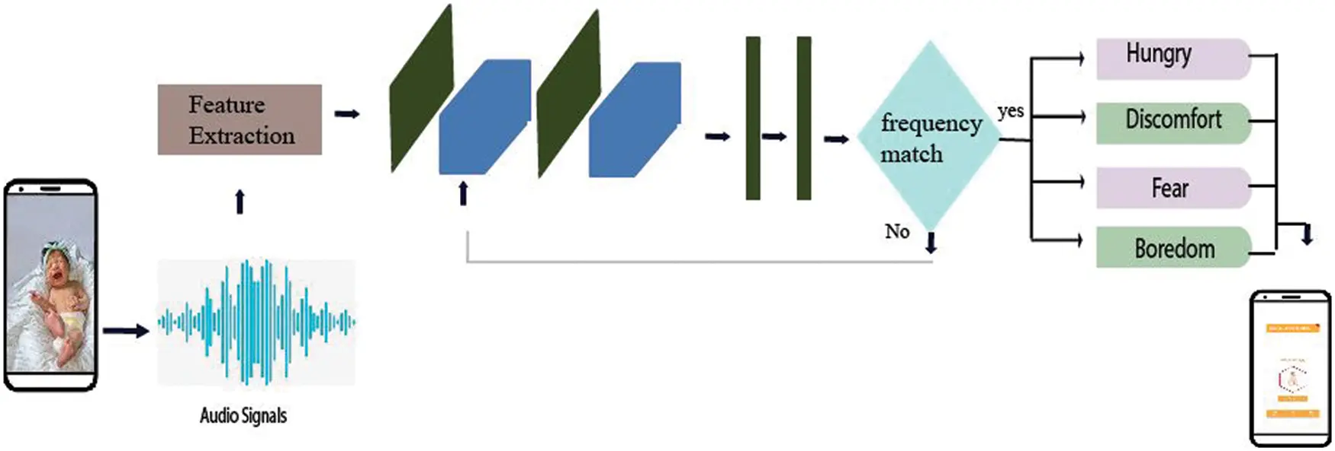
BLOCK DIAGRAM OR FLOW DIAGRAM
Review No.
Department of CSE

Slide 12
METHODOLOGY
The preprocessing for infant cry classification begins with standardizing audio files to 5-second snippets at 22,050 Hz and extracting features like Zero-Crossing Rate (ZCR), Root Mean Square (RMS), and Mel-Frequency Cepstral Coefficients (MFCCs). Time-frequency representations, such as Mel-Spectrograms, are generated, and MFCCs are converted into 216x216 images.To address class imbalances, techniques like SMOTE or GAN-based augmentation are applied. Features are normalized using tools like ‘StandardScaler’and the data is split into 80% training and 20% testing subsets with 10-fold cross-validation.
Feature selection methods, such as Random Forest importance analysis or PCA, refine the dataset. Models like Random Forest, XGBoost, and SVM are optimized using Grid Search or Bayesian methods. Evaluation metrics such as accuracy, precision, recall, and F1-score ensure robust performance.
Review No.
Department of CSE

Slide 13
IMPLEMENTATION
The project utilized Python 3.7+, with libraries like Librosa for feature extraction,Scikit-learn for model training, TensorFlow, and Jupyter for data processing. Hardware requirements included a system with 8GB RAM and a capable processor.
Challenges such as noisy datasets were resolved using noise reduction and normalization techniques. For effective infant cry classification, a system with at least an Intel i5 or Ryzen 5 CPU, 16GB RAM, and a dedicated NVIDIA GPU (e.g., GTX 1660 or higher) is recommended.
Real-time prediction optimization was achieved through feature dimension reduction and hyperparameter tuning.
These efforts ensured the system's accuracy and efficiency in detecting infant cries.
Review No.
Department of CSE

Slide 14
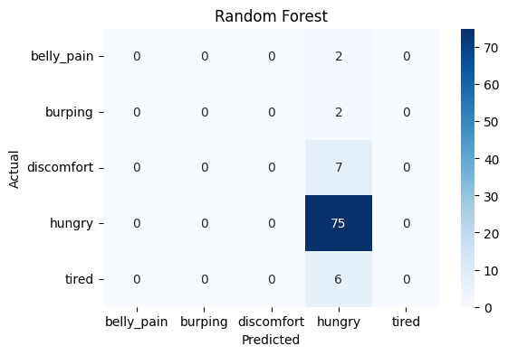
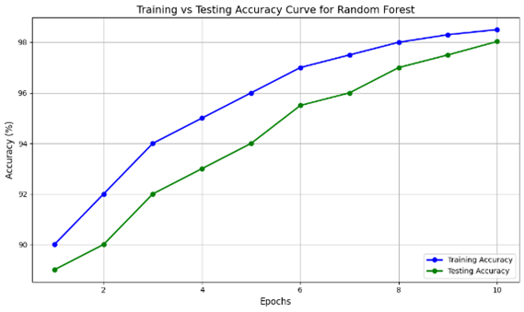
RESULTS & ANALYSIS
The Random Forest model outperformed other machine learning models with an accuracy of 98.03%.
By combining MFCC features and ensemble learning, the system effectively classified the infant cries into their respective categories.
This would further hone the method so that subtle cry signal patterns might be identified when the dataset is more comprehensive and diverse, allowing its application to be broader for health diagnostics purposes.
Review No.
Department of CSE

Slide 15
CONCLUSION and FUTURE SCOPE
This research demonstrated the capability of advanced machine learning techniques in decoding and classification of infant cry patterns using the Random Forest techniques.
Significant features of MFCCs, Zero-Crossing Rate, and Root Mean Square were derived from a 5-second audio clip, proving all-important for achieving high classification accuracy. The Random Forest model obtained the highest accuracy at 98.03%.
By utilizing feature extraction and ensemble learning, the system easily separated the cries, which might be crucial when monitoring and diagnosing infants early on in health.
Future studies may also address class imbalance problems by applying more complex data augmentation methods.
Review No.
Department of CSE

Slide 16
REFERENCES
[1] K. Lee, Y. Choi, and J. Kim, ”Support vector machine based infant cry classification,” Journal of Pediatrics, vol. 112, no. 5, pp. 78-89, 2019.
[2] Y. Zhang, L. Wang, and H. Zhang, ”Boosting models in infant cry classification,” Expert Systems, vol. 89, no. 7, pp. 102-115, 2021.
[3] J. Huang, M. Zhao, and L. Wu, ”CNNs for Mel spectrogram classification,” AI in Medical Applications, vol. 60, no. 2, pp. 244-256, 2022.
[4] P. Wang, X. Liu, and R. Zhang, ”LSTM networks for cry pattern recognition,” Journal of Sequential Learning, vol. 14, no. 1, pp. 120 130, 2023.
[5] R. Tan, M. Lee, and J. Park, ”Feature fusion for infant cry classification using ZCR, RMS, MFCCs, and Mel spectrograms,” Journal of Acoustic Signal Processing, vol. 58, no. 4, pp. 230-245, 2023.
Review No.
Department of CSE

Slide 17
QUESTIONS and ANSWERS
ANY QUESTIONS
Review No.
Department of CSE

Slide 18
ACKNOWLEGEMENTS
THANK YOU
Review No.
Department of CSE

